Slide 1
스터디카페 좌석 키오스크
IT공학전공 2114884 임가윤
Notes:
ID=d924773e-9a16-4d6d-9803-8cb819e99682 Recipe=text_billboard Type=TextOnly Variant=0 FamilyID=AccentBoxWalbaum_Zero

Slide 2
클래스 관계도
Thread
Clock
MyKioskMain
---------------------
- mk
MyKiosk1
MyKiosk2
Extends JPanel
MyKiosk
---------------------
- Kiosk 1
Kiosk 2
Kisok 3
Kiosk 4
Extends JPanel
MyKiosk3
MyKiosk4
Extends JPanel
Extends JPanel

Slide 3
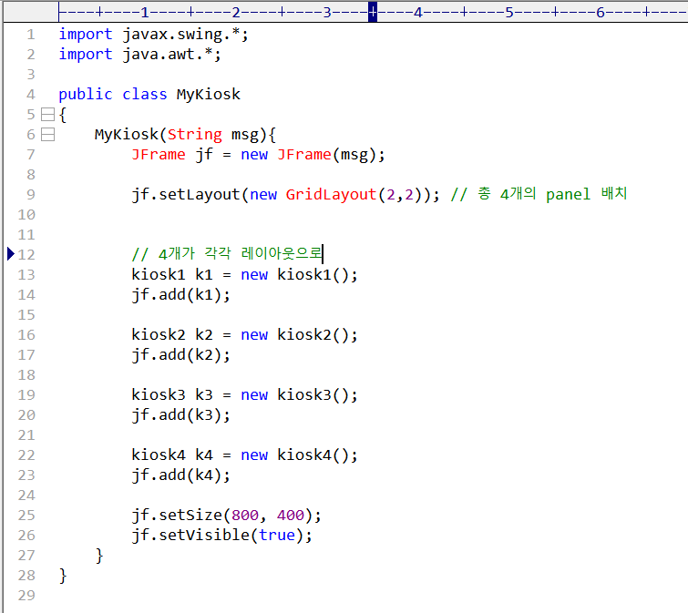
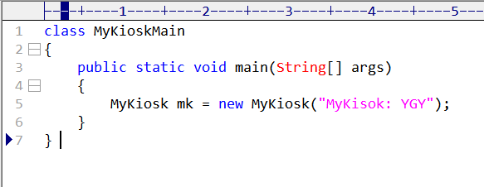

Slide 4
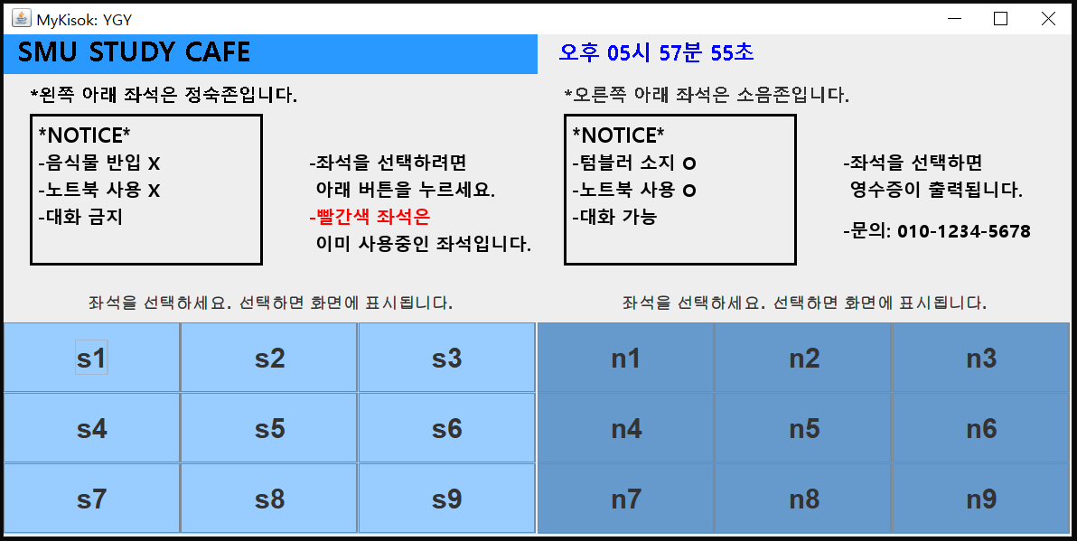

Slide 5
1
2
4
3

Slide 6
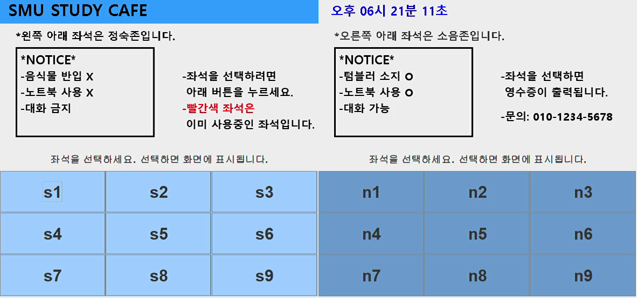

Slide 7
감사합니다.

